Slide 1
UNIVERSITY COLLEGE FOR WOMEN, KOTI,HYDERABAD
NATIONAL SERVICE SCHEME
Report of the activities done
During lockdown

Slide 2
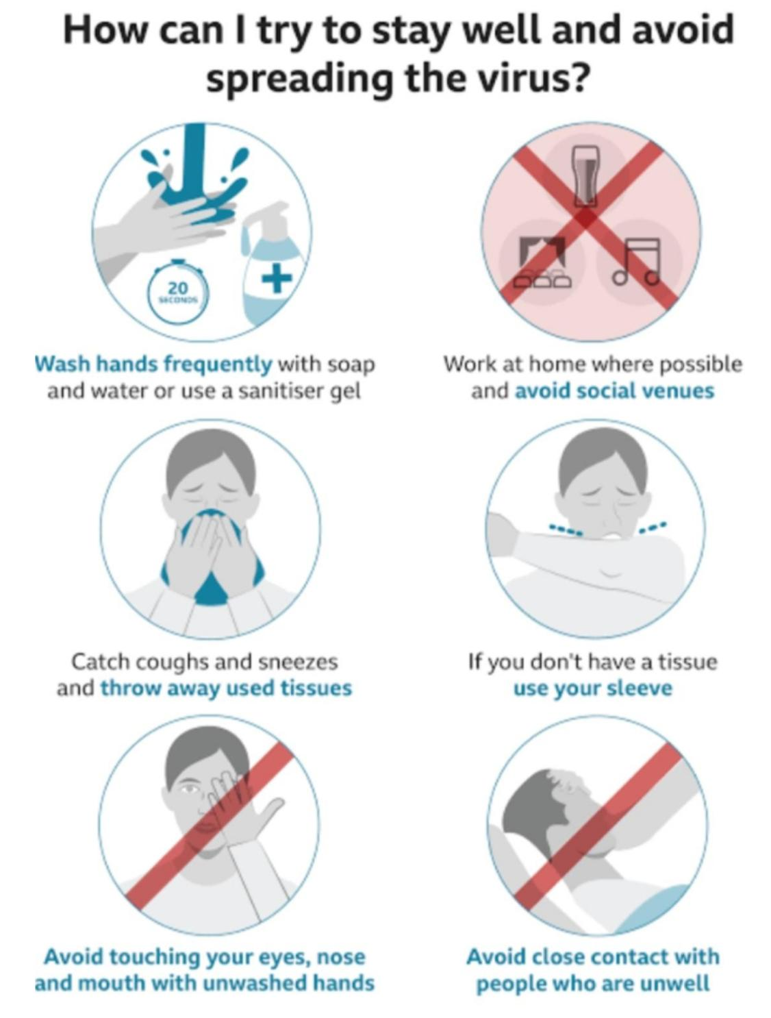
COVID - 19
Coronavirus disease (Covid – 19 ) is an Infectious disease caused by newly discovered virus called as Coronavirus.
The Covid – 19 virus spreads primarily through droplets of saliva or discharge from nose when the infected person coughs or sneezes,so it is important that you also practice respiratory etiquette.

Slide 3
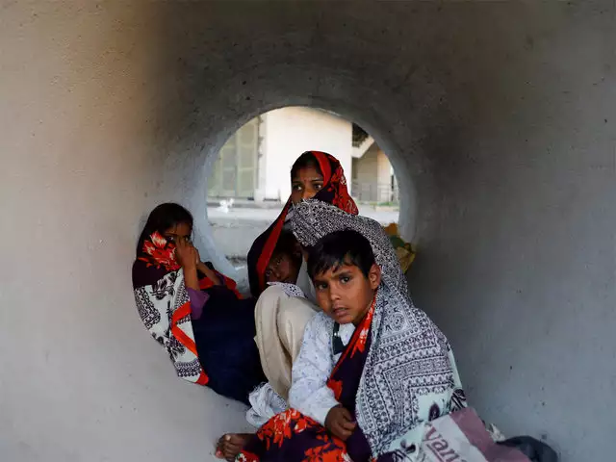
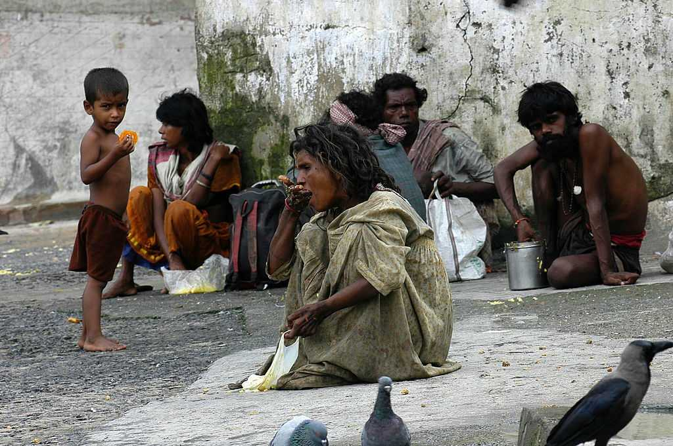
Corona disease
Has a deep impact on low income individuals. Low income neighbourhoods are disapproportionately hit by coronavirus cases. Millions of low income people may lack access to health care due to being uninsured or underinsured. Many low income workers in service jobs have become unemployed.

Slide 4
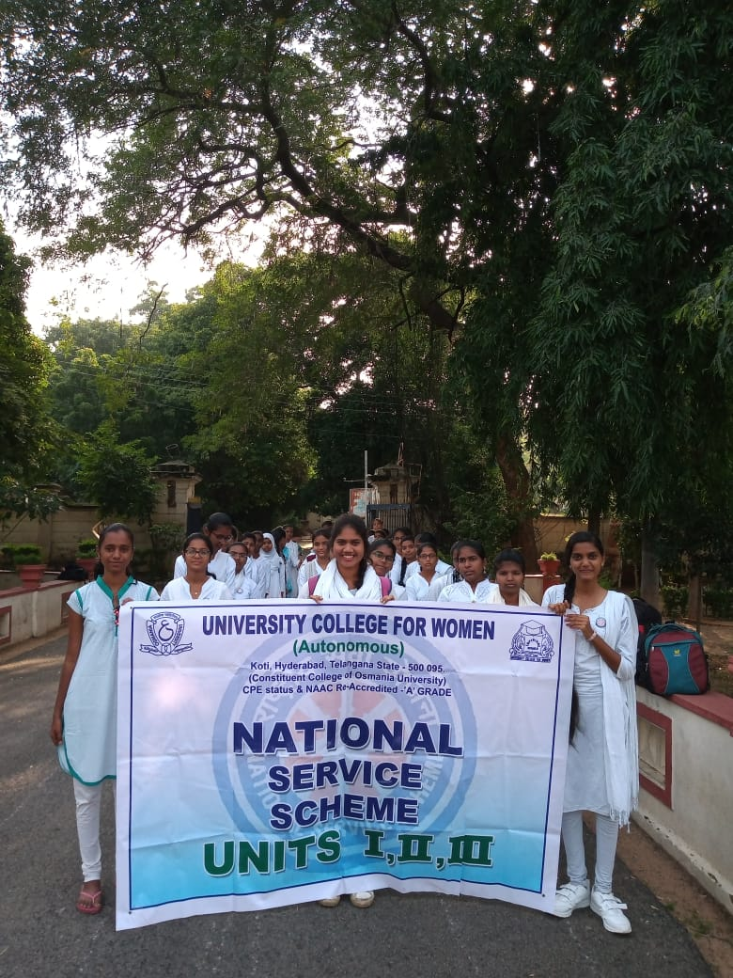
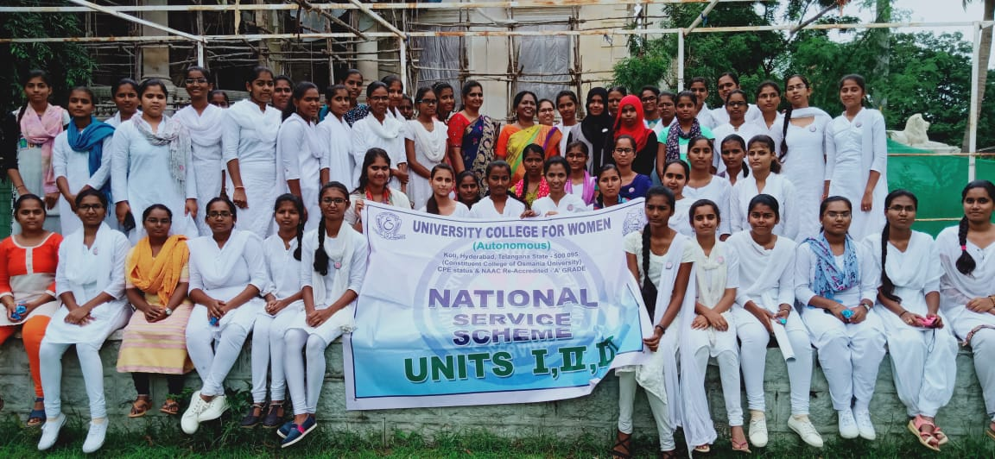
Activities which are conducted by NSS cell during lockdown are as follows:-

Slide 5
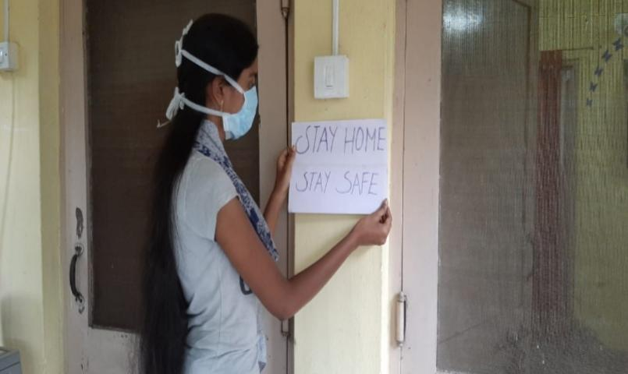
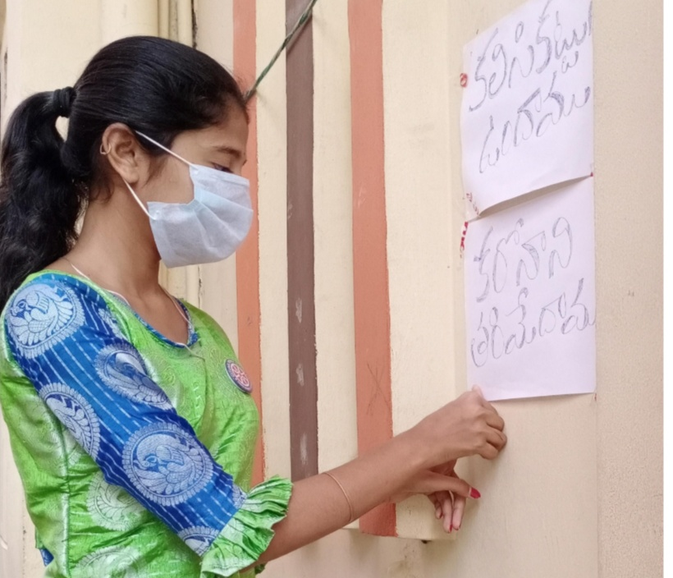
ACTIVITY 1: Awareness among colonies Making posters and slogans and putting them up of neighbourhood houses has been a part of awareness. Our Volunteers Sneha and Laharika educating neighbours and creating awareness.

Slide 6
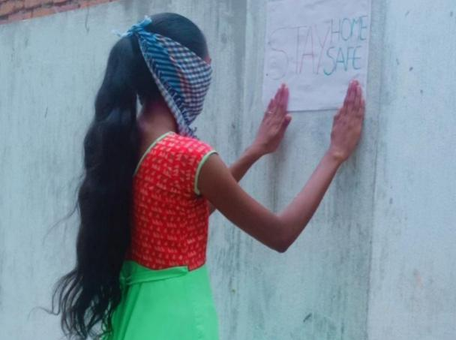
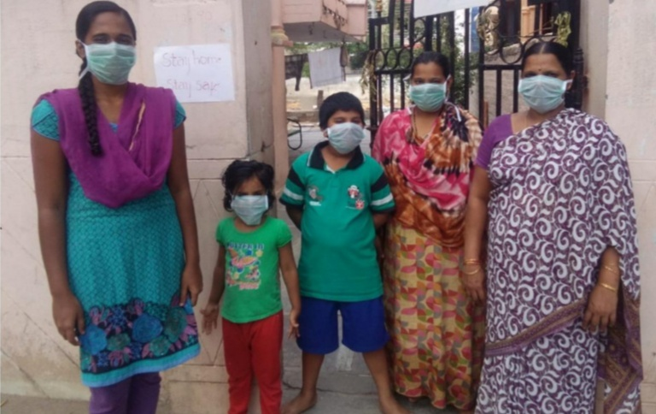
Volunteers Shashi and Ramani creating Awareness.

Slide 7
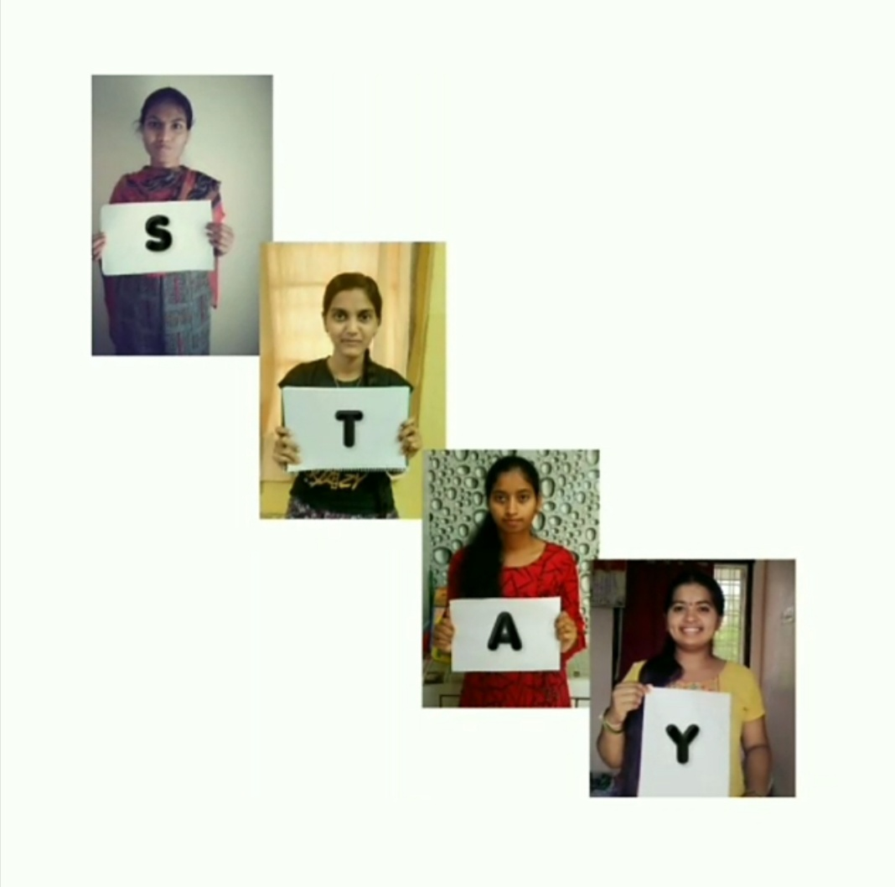
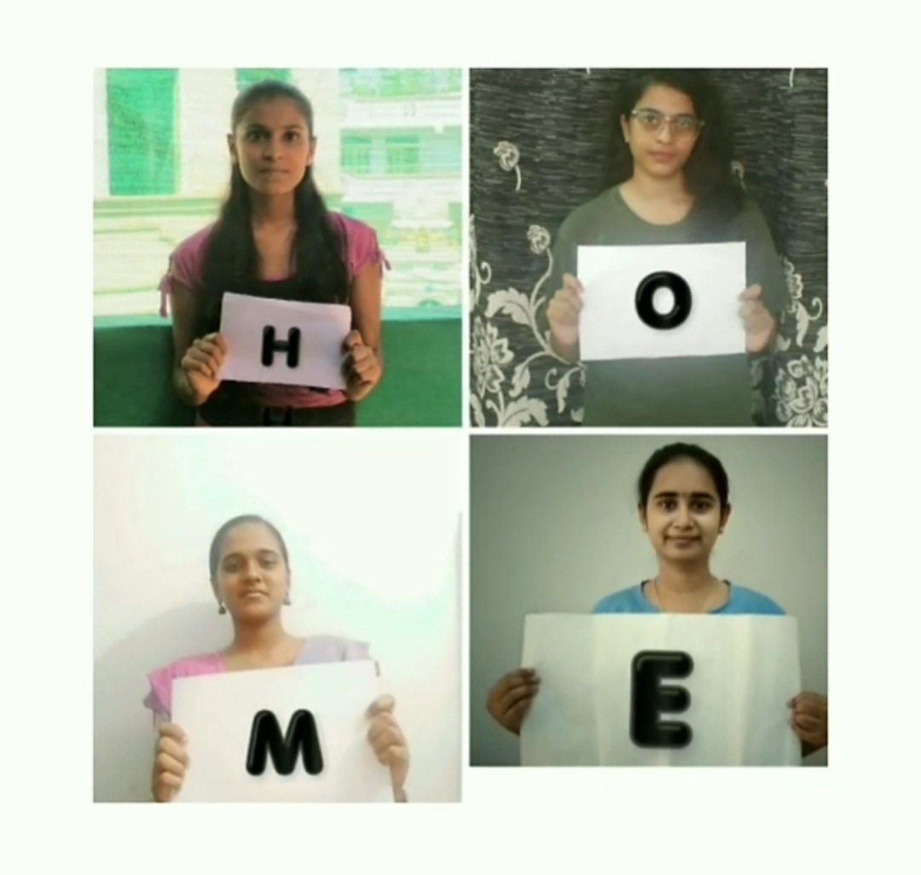
We came up with Virtual Video Awareness idea by creating different videos and posters, sending it to our friends and posting them online. This has got a huge response.

Slide 8
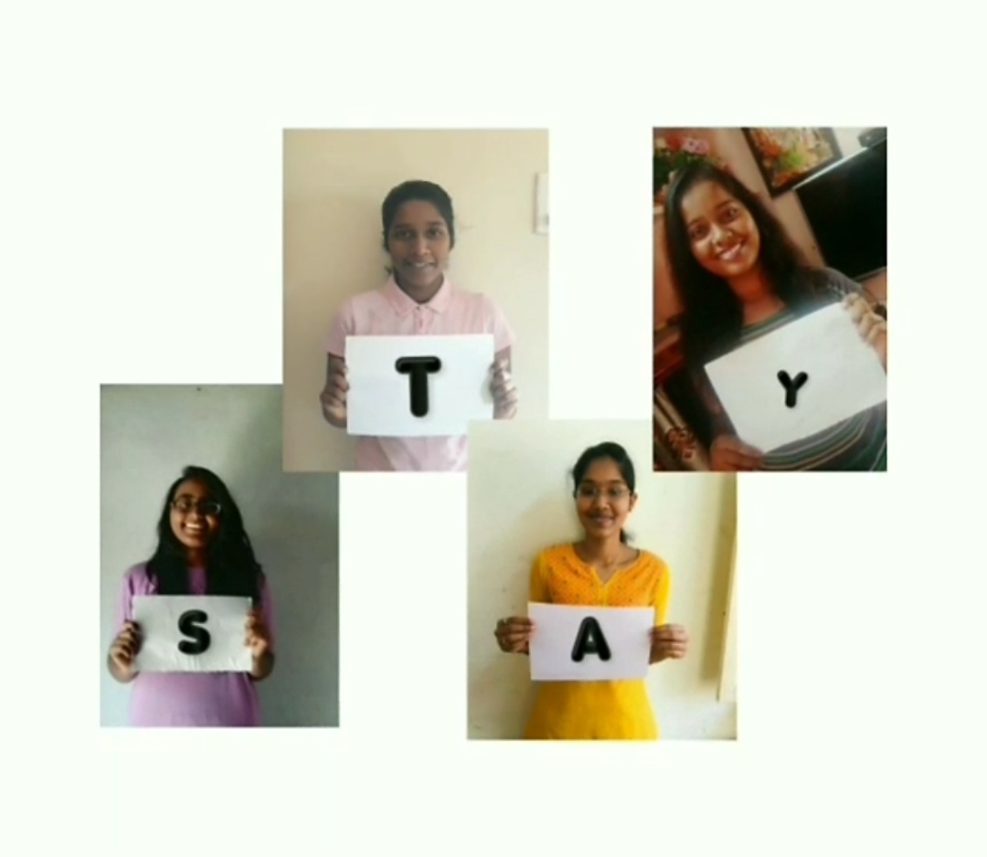
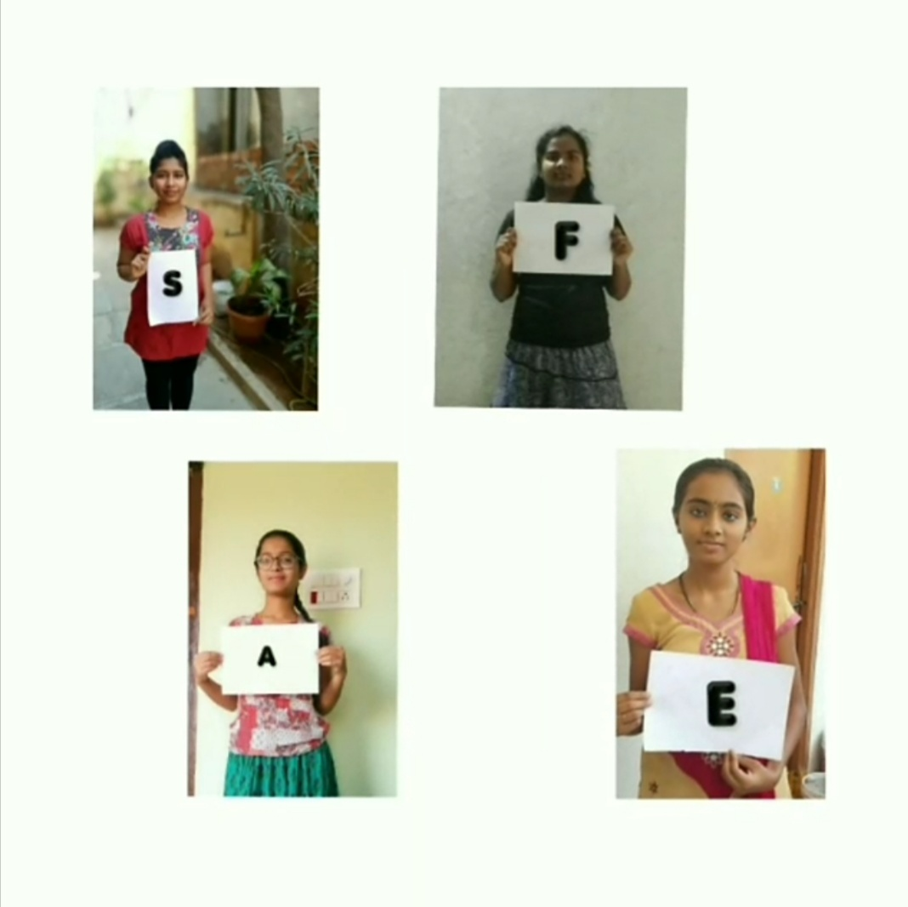

Slide 9
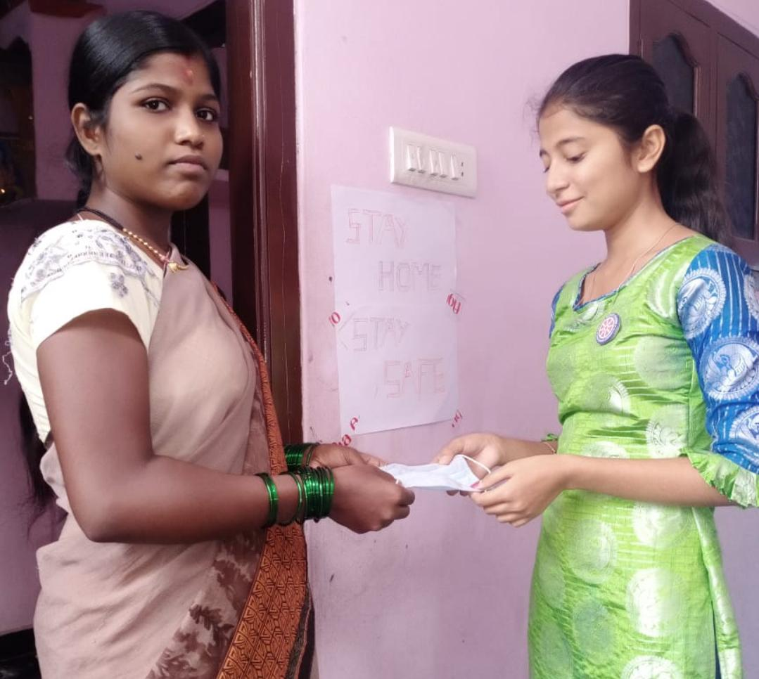
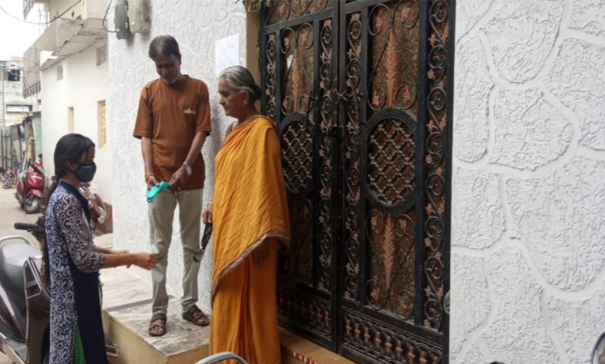
ACTIVITY 2 : Mask distribution Number of masks distributed are 190

Slide 10
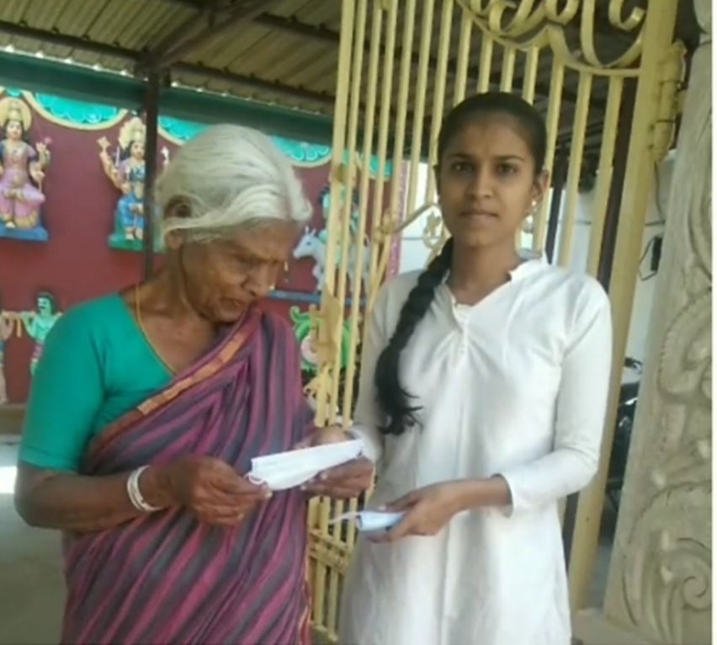
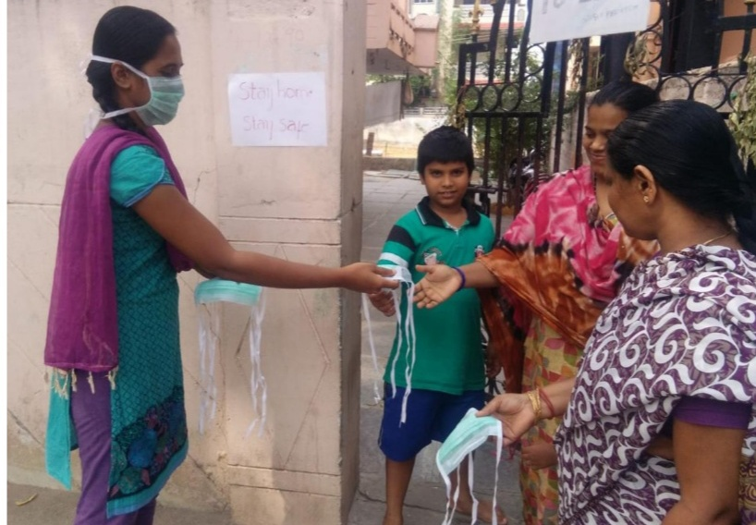
Masks distribution by second year Volunteers Srilekha and Ramani near Hayatnagar.

Slide 11
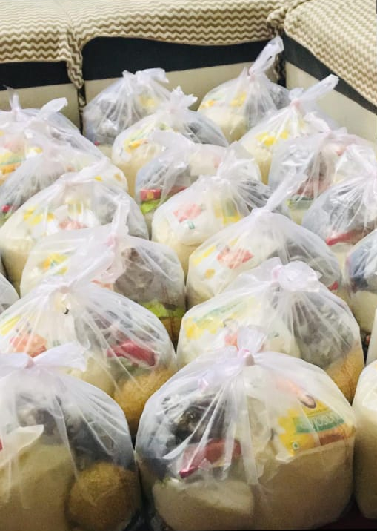
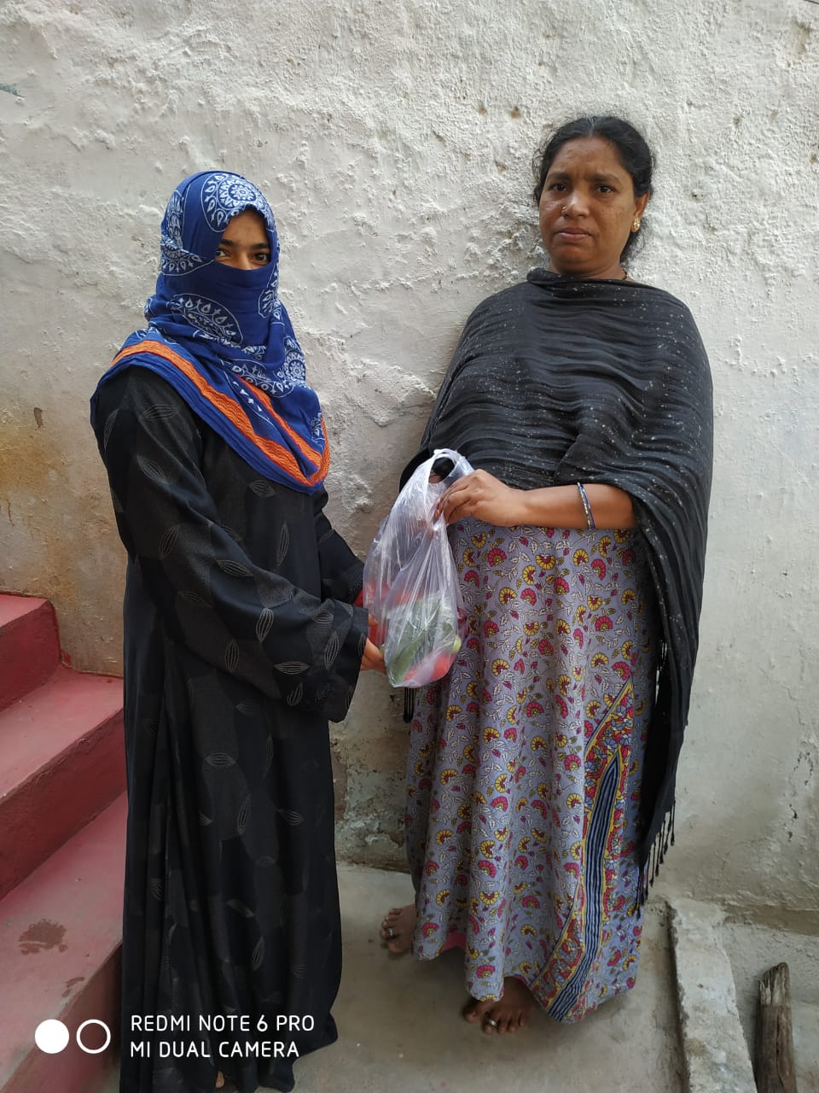
Activity 3: Groceries distribution Our first year volunteers Bhavana, Samreen, Meghana distributing groceries in their respective areas.

Slide 12
Activity 4: Deepothsav (lightening dias)

Slide 13
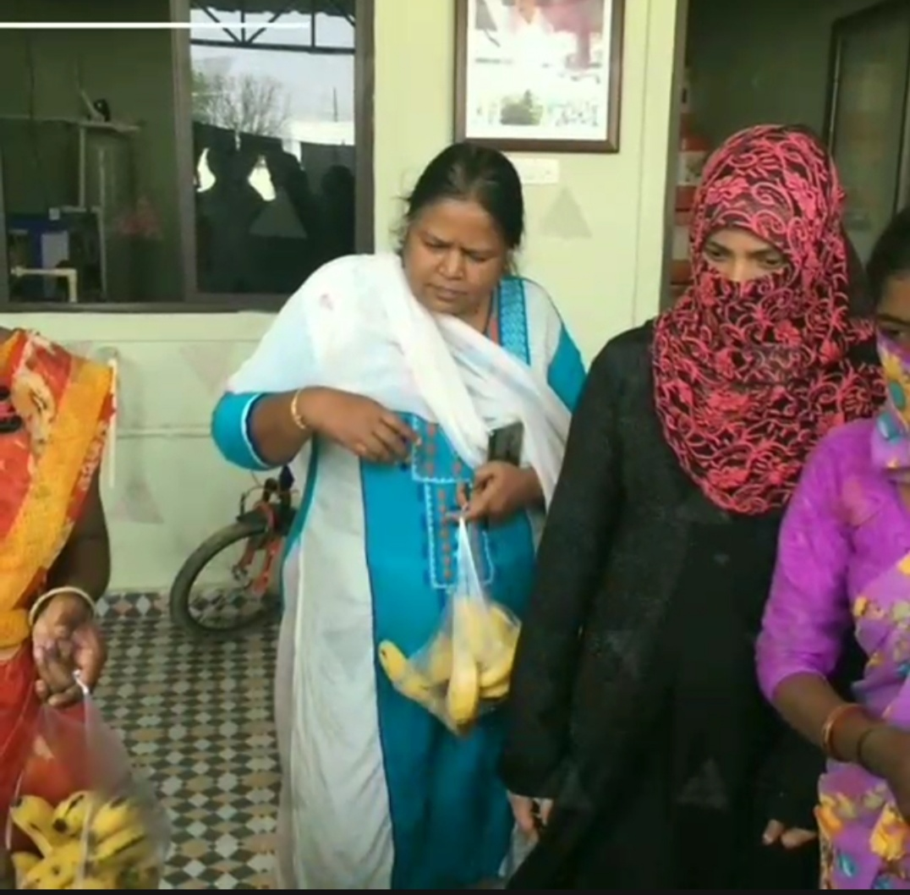
Activity 5: Food and fruits distribution
Our Programme officer M. Dorcas distributing food near hospitals and slams around her areas.

Slide 14
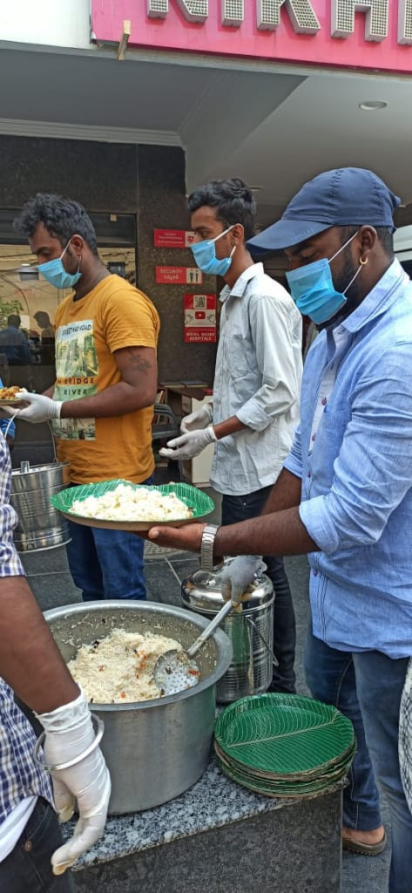
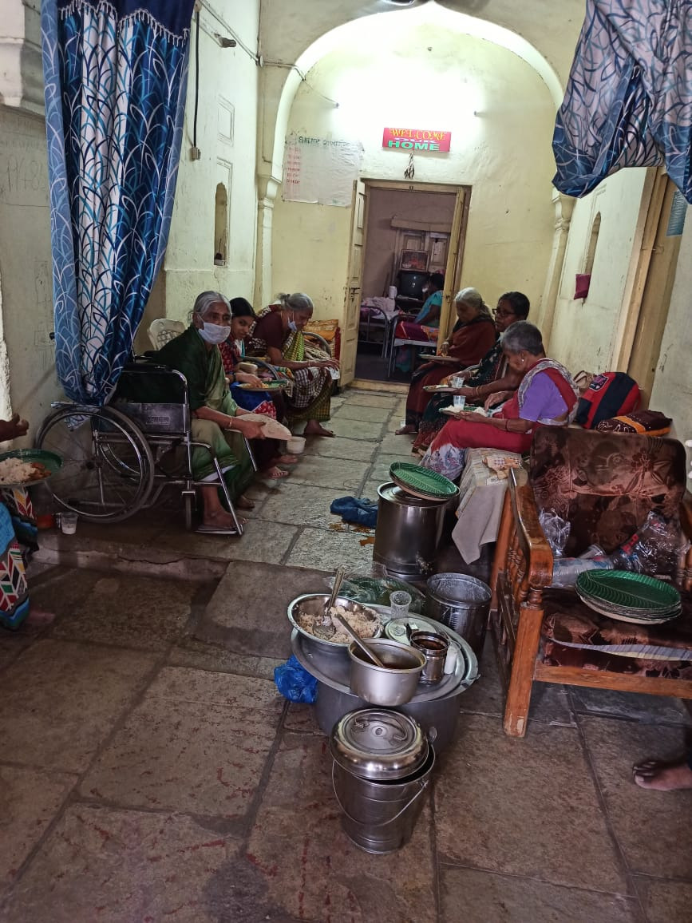
Breakfast and lunch distribution: This has been done by volunteers along with their families. Mostly covered areas are L.B. Nagar, Santhoshnagar and Balapur.

Slide 15
Activity 6: Money contribution to adopted village during camp. We have adopted Tunikibollaram, Zapthisingaipalli and Chinna thimmapur village during the camp of 2019. We have collected money from willing volunteers and sent them for further use.

Slide 16
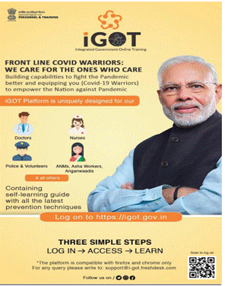
Activity 7: Installation of helpful app during corona Our Government has issued and approved few app like Arogya Sethu and iGot apps to be present in the mobile phones. These apps we let us know before hand if we are near to any affected person or if we are harmful to our families. It also gives precautions and measures to avoid COVID. We asked all our 300 volunteers to install and were successful in fulfilling it.

Slide 17
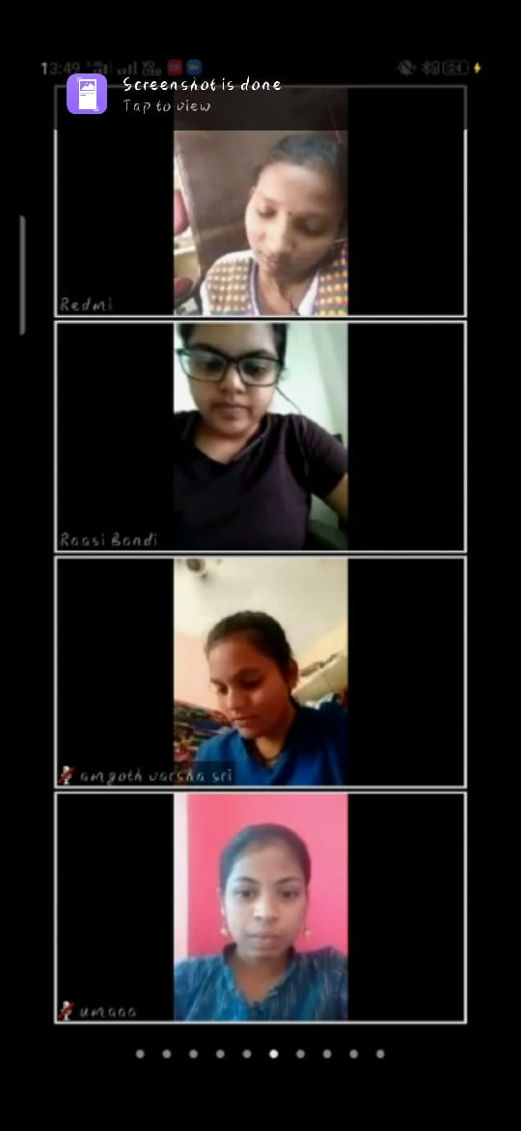
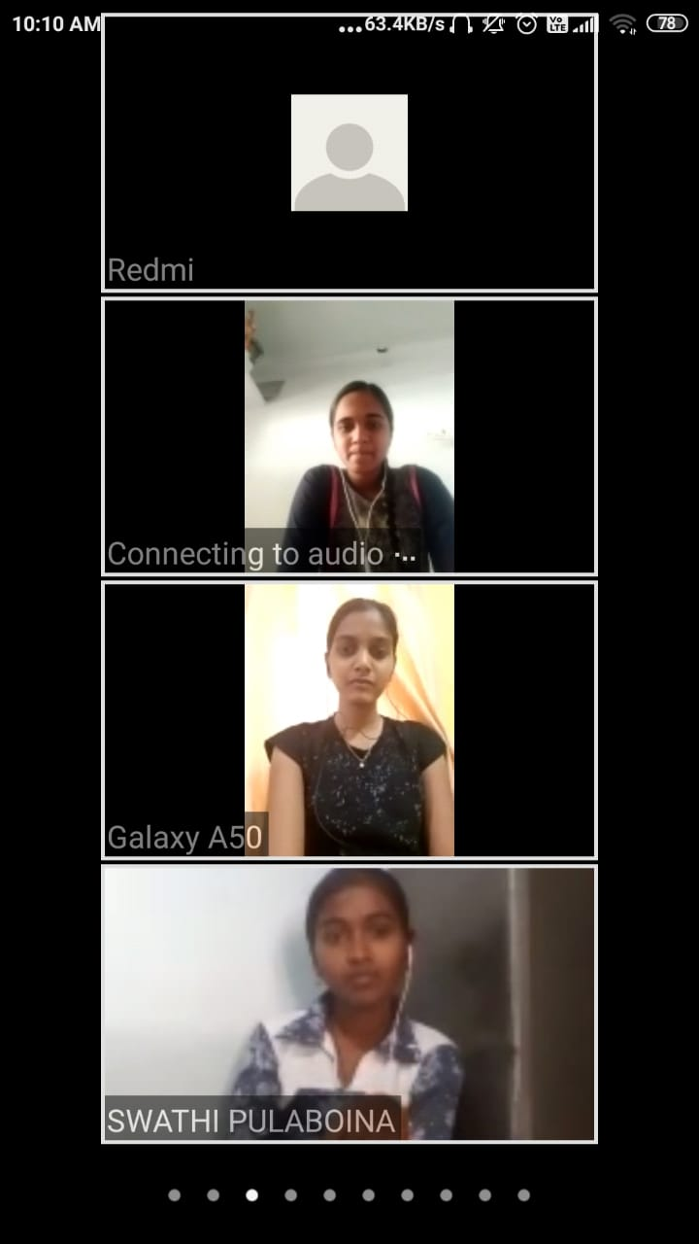
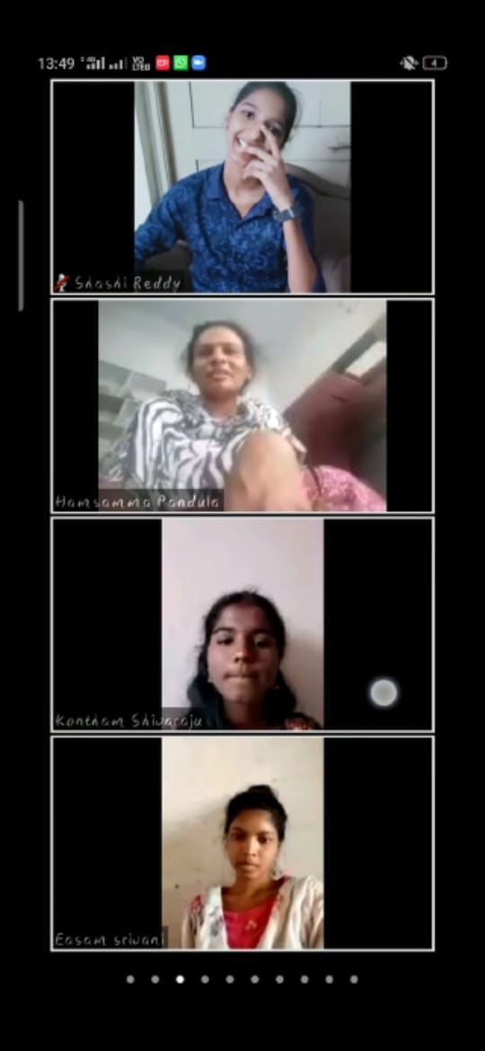
Activity 8: Virtual awareness to volunteers

Slide 18
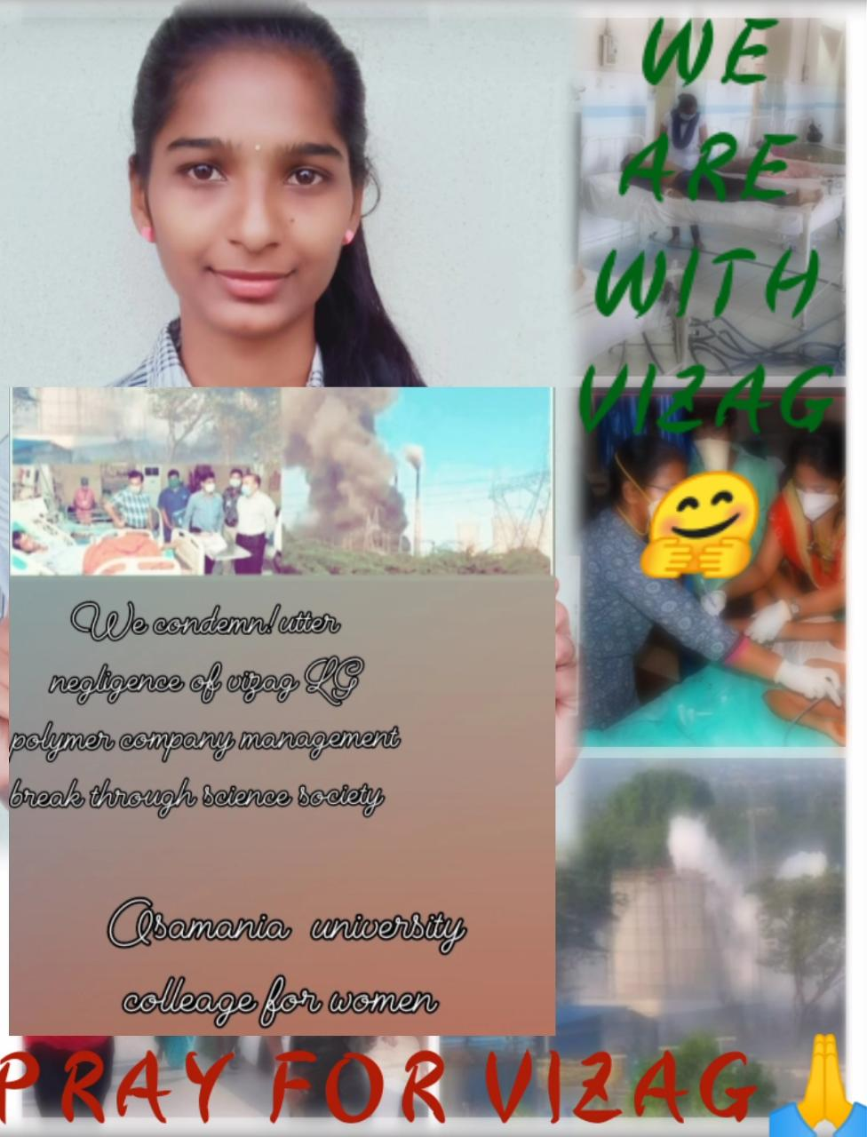
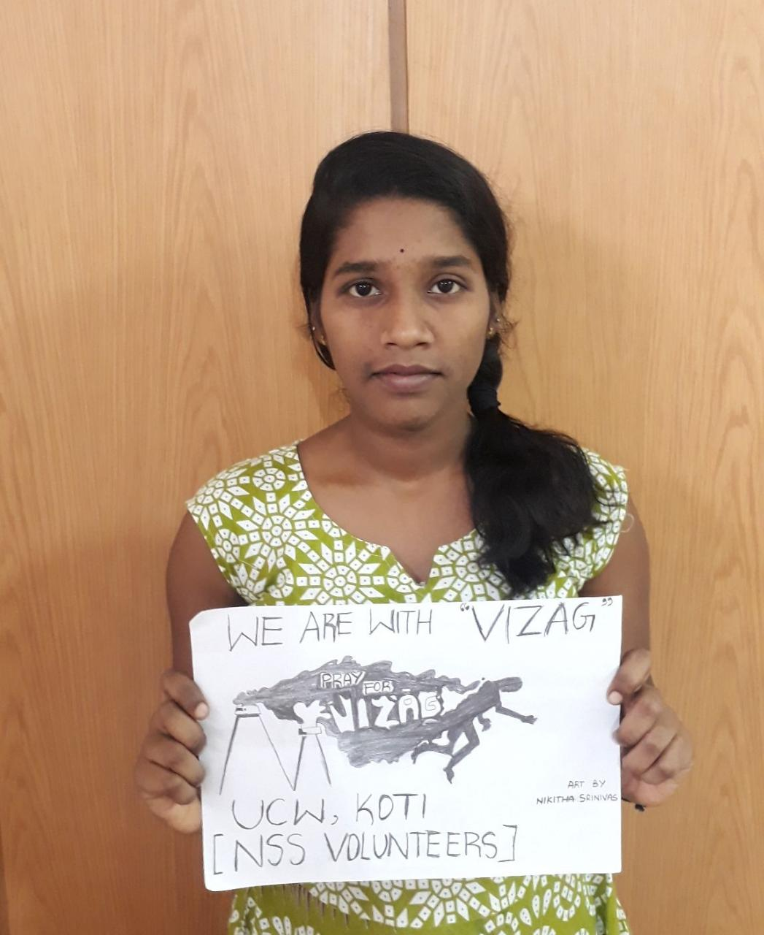
Activity 9: Revolting Vizag Tragedy We, with the help of BREAKTHROUGH SCIENCE SOCIETY have come up with social opposing method of vizag LG polymer gas leak incident. More than 200 volunteers have prepared posters and posted stories in their respective instagram, whats app and facebook accounts.

Slide 19
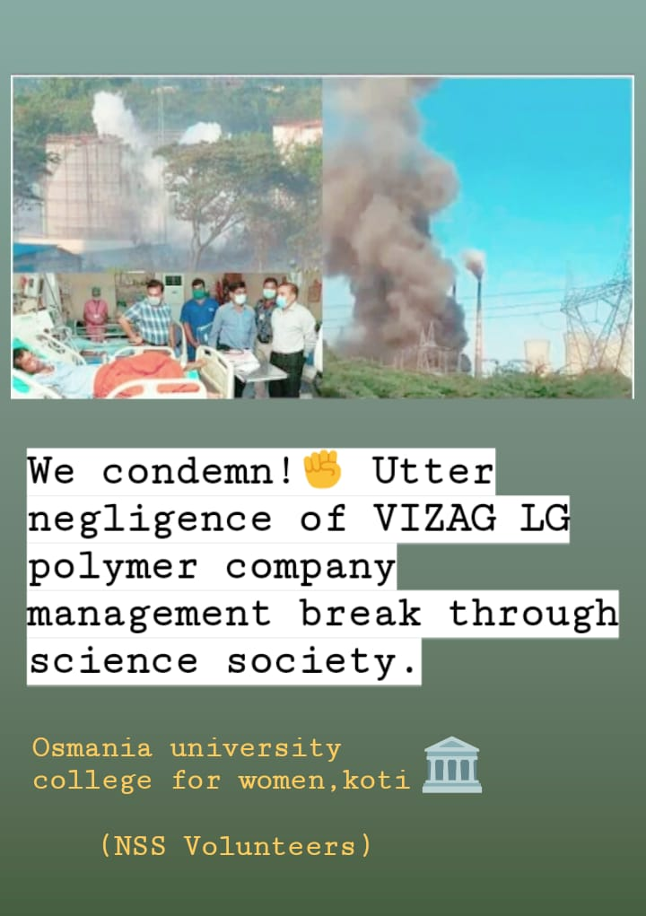
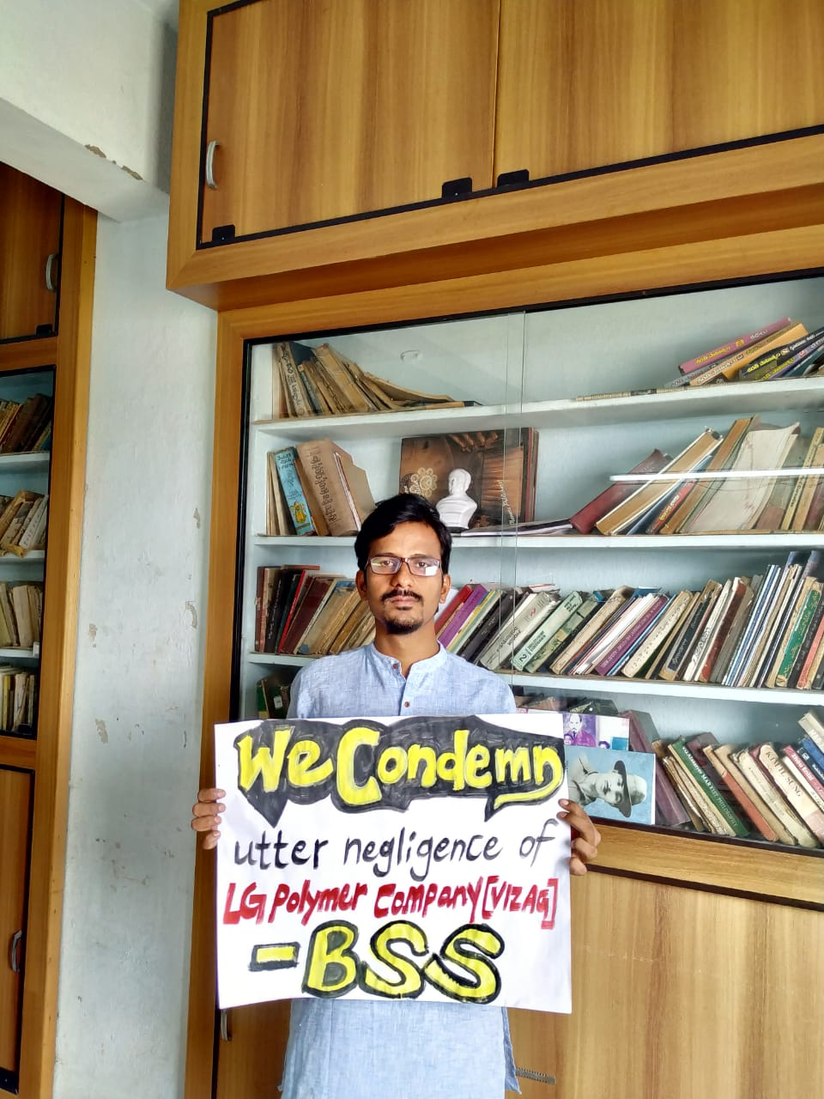
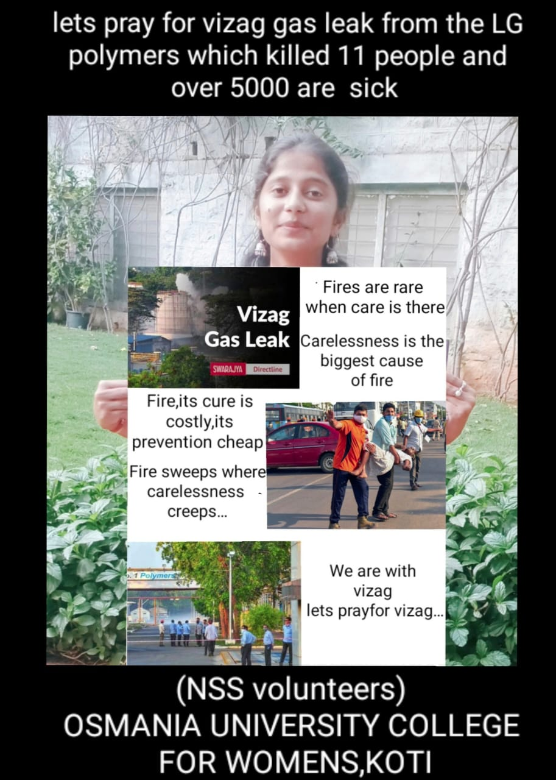

Slide 20
ACTIVITY 10: Creative video making. Many videos has been creatively done and organised by our volunteers. Shashi and srilkeha has taken lead of this activity. One of the video has been displayed.

Slide 21
THANK YOU

